Slide 1

InstaStay: A Modern Hotel Booking Platform
A seamless MERN stack solution for effortless hotel discovery, booking, and management

Slide 2
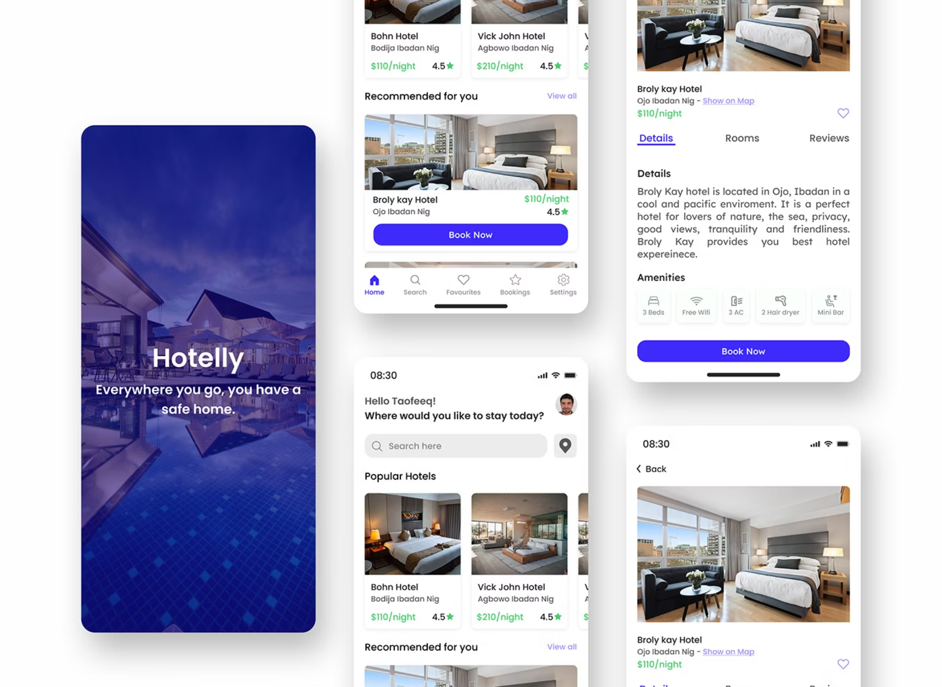


Platform Overview
What Is InstaStay?
InstaStay is a comprehensive hotel booking platform built with the MERN stack, designed to deliver an intuitive and secure booking experience. The platform connects travellers with accommodations whilst providing hotel owners with powerful management tools.
Key Highlights:
Seamless hotel search and booking
Secure payment processing
Mobile-responsive design
Real-time availability tracking

Slide 3





Core User Features
Intelligent Search
Detailed Listings
Browse hotels by city, destination, or specific dates. Filter results by price range, amenities, and guest ratings to find the perfect accommodation.
Explore comprehensive hotel pages featuring high-quality images, complete amenity lists, room types, pricing details, and authentic guest reviews.
Secure Booking
Booking Management
Reserve rooms instantly and complete secure payments through integrated Stripe processing. Receive instant confirmation and booking details.
Access your booking history, view upcoming reservations, and manage modifications or cancellations directly from your dashboard.

Slide 4





Administrator Capabilities
Hotel Management
Availability Control
Booking Oversight
Add new properties, update existing listings, modify room details, and remove hotels as needed. Full control over property information and availability.
View real-time booking calendars, block dates for maintenance, and adjust room availability to reflect current inventory and seasonal changes.
Monitor all reservations, track guest information, process cancellations, and manage special requests. Complete visibility into booking activity.

Slide 5




Technology Stack
Built with modern, industry-standard technologies ensuring reliability, scalability, and maintainability
Frontend
Backend
Database
React.js for component-based UI
Bootstrap framework
CSS3 for styling
Responsive design principles
Node.js runtime
Express.js framework
RESTful API architecture
JWT authentication
MongoDB (NoSQL)
Atlas cloud hosting
Flexible schema design
Efficient data querying

Slide 6


Security & Payment Integration
Secure Payment Processing
InstaStay integrates Stripe, a PCI-compliant payment gateway trusted by millions of businesses worldwide. All transactions are encrypted and processed securely, ensuring guest payment information remains protected.
Authentication & Security
JSON Web Tokens (JWT) provide stateless authentication, ensuring secure user sessions. Passwords are hashed using industry-standard bcrypt algorithms, protecting user credentials whilst maintaining system performance.

Slide 7



Visual Experience & Media
Cloudinary Image Management
Rich Media Experience
High-performance image hosting and delivery ensures fast loading times. Automatic optimization, responsive images, and CDN distribution deliver crisp visuals across all devices.
Multiple high-quality images per listing showcase amenities, rooms, and facilities. Gallery views allow guests to explore properties visually before booking.

Slide 8





Responsive Design Principles
Mobile-First
Optimized touch interfaces and streamlined navigation for smartphones
Tablet Ready
Adaptive layouts that maximize screen real estate on tablets
Desktop Power
Full-featured experience with advanced filtering and management capabilities
The platform adapts seamlessly to any screen size, ensuring consistent performance and usability across all devices. Fast loading times and intuitive interfaces keep users engaged.

Slide 9





Deployment & Infrastructure
Frontend Hosting
Vercel provides lightning-fast global CDN delivery, automatic SSL certificates, and instant cache invalidation for optimal frontend performance.
Backend Services
Render hosts the Node.js backend with auto-scaling capabilities, ensuring reliable API availability and handling traffic spikes efficiently.
Database Layer
MongoDB Atlas delivers managed database services with automated backups, monitoring, and global replication for data durability.

Slide 10

Key Benefits & Value Proposition
Fast Time to Market
Scalable Architecture
Modern MERN stack enables rapid development and deployment with reusable components and efficient development workflows.
Cloud-native infrastructure and NoSQL database design allow horizontal scaling as user base and hotel inventory grow.
Enhanced User Experience
Reduced Maintenance
Responsive design, fast performance, and intuitive interfaces create seamless booking experiences that drive conversions.
Managed services for frontend, backend, and database minimize operational overhead whilst ensuring platform reliability.

Slide 11




Future Scope & Roadmap
Exploring potential enhancements and strategic growth areas for InstaStay to further revolutionize hotel booking and management.
Advanced Features
Expansion Plans
Analytics & Insights
AI-powered personalization for hotel recommendations.
Dynamic pricing algorithms to optimize revenue.
Integrated loyalty programs to reward frequent guests.
Multi-language support for global accessibility.
Integration of diverse international payment methods.
Development of dedicated iOS and Android mobile apps.
Deep guest behavior analytics for improved targeting.
Revenue optimization tools and forecasting.
Customizable performance dashboards for hotel owners.

